Slide 1
Genetics – Patterns of Inheritance

Slide 2
Syllabus:
Frequencies of genotypes and phenotypes of offspring are determined by patterns of inheritance, including dominance, autosomal and sex-linked alleles, multiple alleles and polygenes
Conduct investigations, including the use of probabilities to predict inheritance patterns safely, competently and methodically for the collection of valid and reliable data (SIS)
Select, construct and use appropriate representations, including Punnet squares, to communicate conceptual understanding, solve problems and make predictions (SIS)
Use punnet squares and pedigrees to show the frequencies of genotypes and phenotypes of offspring are determined by patterns of inheritance, including dominance, autosomal and sex-linked alleles, multiple alleles and polygenes
Essential
Question:

Slide 3
What you need to complete
BIOLOGY WA UNITS 3&4
Chapter 5 Genetics pg. 124 - 164
Questions
Set 5.1 pg. 129 Q 1-8
Set 5.2 pg. 134 Q 1–8
Set 5.3 pg. 137 Q 1-4
Set 5.4 pg. 138 Q1-5
Set 5.5 pg. 144 Q1-5
Set 5.6 pg. 147 Q1-6
Set 5.7 pg. 150 Q1-3
Set 5.8 pg. 157-158 Q1-7
BIOZONE
179, 180, 182, 183,184, 185, 186, 187, 188, 189, 193, 196,197, 198, 199, 200

Slide 4
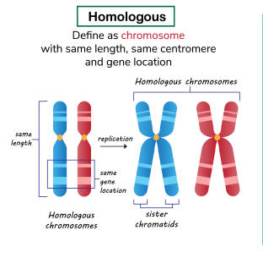
Genetics introduction
Topic Question 1: Define the following terms; homologous chromosomes, genes, recessive & dominant alleles
Homologous Chromosomes
Diploid organisms have pairs of chromosomes
The chromosomes in the same pair have the same genes of loci
https://www.istockphoto.com/photos/homologous-chromosomes

Slide 5
Genetics introduction
Genes
Are really specific locations or loci on the chromosome
Alleles are the specific DNA sequences at gene locations
One chromosome’s allele’s DNA code may be slightly different from the other chromosome’s allele’s DNA code
Often scientists use alphabet letters to symbolise the alleles that an organism has
Different alleles may produce different polypeptides after transcription and translation takes place
Some alleles may not produce a polypeptide

Slide 6
Genetics introduction
Dominant Allele
Allele A
Scientists often use an uppercase letter to symbolise an allele that is dominant
Dominant alleles can affect (positively or negatively) the organisms health, appearance or cellular function
If the alleles is dominant, its effects can be ‘seen’ or are observable, even if the organism only has one of them
Phenotype

Slide 7
Genetics introduction
Recessive allele
Allele a
Scientists often use a lowercase letter to symbolise an allele that is recessive
Recessive alleles can affect the organism’s health, appearance, or cellular function.
If the allele is recessive, its effects may not be seen if the organism also has a dominant allele on the other chromosome in the same gene that has different effects

Slide 8
Genetics introduction
Genotype
Scientists use the term ‘genotype’ to describe the alleles that the organism has for the genes the scientist is studying
It is the genetic composition of an organism for a particular trait, specifically the set of alleles (one from each parent) that an organism has for a particular trait

Slide 9
Genetics introduction
Topic Question 2: Define the terms heterozygous and homozygous
Heterozygous
Possessing two different alleles of
a gene; dominant allele will be expressed
Aa is a heterozygous genotype

Slide 10
Genetics introduction
Topic Question 2: Define the terms heterozygous and homozygous
Homozygous
Possessing two identical alleles of a gene
AA is a homozygous dominant genotype
aa is a homozygous recessive genotype
Pure breed
Identical set of alleles

Slide 11
Genetics introduction
Topic Question 3: What can a punnet square be used to show?
Punnet square
A diagram that shows all possible combinations of alleles and, therefore, all possible genotypes of offspring
 | T | t
T | TT | Tt
t | Tt | tt

Slide 12
Genetics introduction
Topic Question 4: In an exam question if you draw a punnet square what must you include?
Key:
Alleles
T = tall (dominant allele)
t = short (recessive allele)
Cross
Parent cross = Tt × Tt
Genotype of the male
Genotype of female
 | T | t
T | TT | Tt
t | Tt | tt
4 Possible Genotypes of offspring
Key showing alleles. Only use letters that look different as Caps & Lower case!
Must show genotypic & phenotypic ratios
Genotype ratio: | 1TT : 2Tt : 1tt | OR | 1/4TT : 1/2Tt : 1/4tt | OR | 25%TT : 50%Tt : 25%tt
Phenotype ratio: | 3 tall : 1 short | OR | ¾ tall : ¼ short | OR | 75% tall : 25% short

Slide 13

Genetics introduction
Topic Question 5: Describe Mendel’s Laws of inheritance
https://www.youtube.com/watch?v=Mehz7tCxjSE

Slide 14
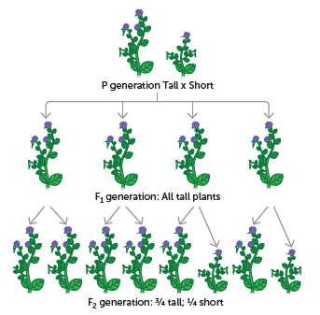
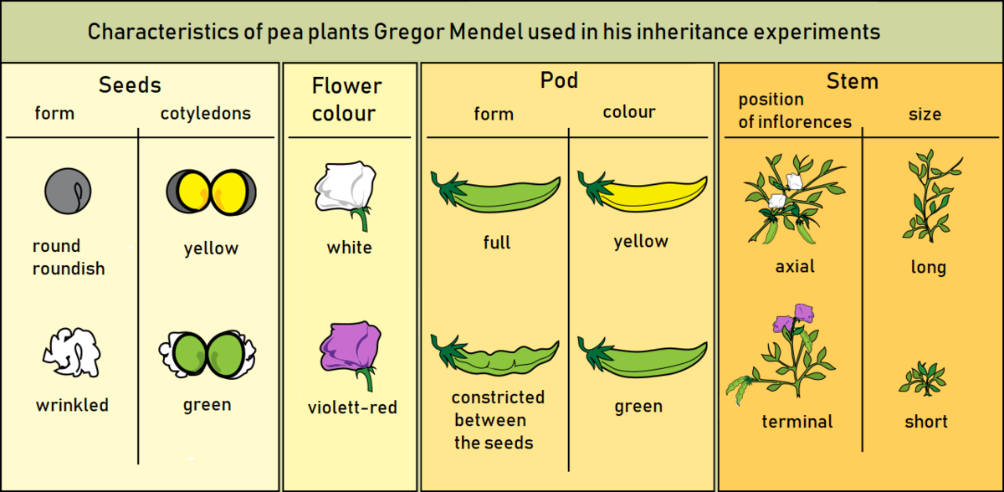
Genetics introduction
Topic Question 5: Describe Mendel’s Laws of inheritance

Slide 15
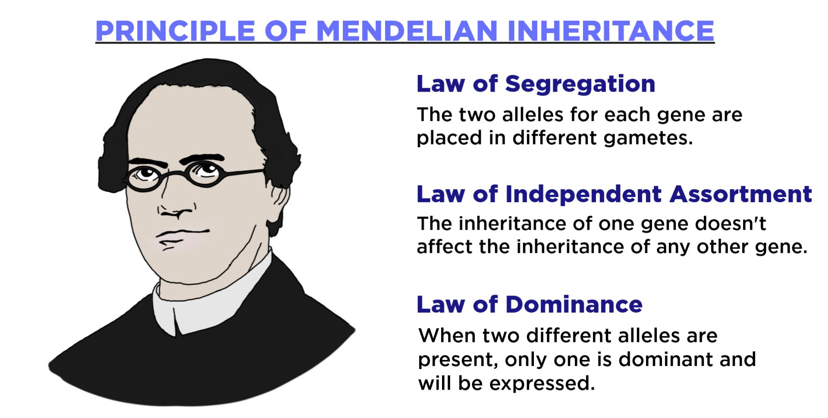
Genetics introduction
Topic Question 5: Describe Mendel’s Laws of inheritance
https://www.youtube.com/watch?v=Mehz7tCxjSE

Slide 16
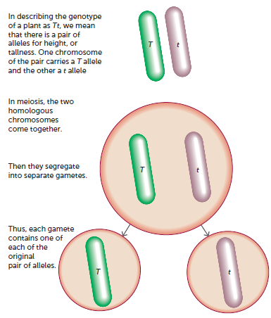
Genetics introduction
Topic Question 5: Describe Mendel’s Laws of inheritance
Law of segregation
The segregation of alleles in inheritance corresponds to the segregation of homologous chromosomes in meiosis.
Meaning each gamete contains one allele

Slide 17
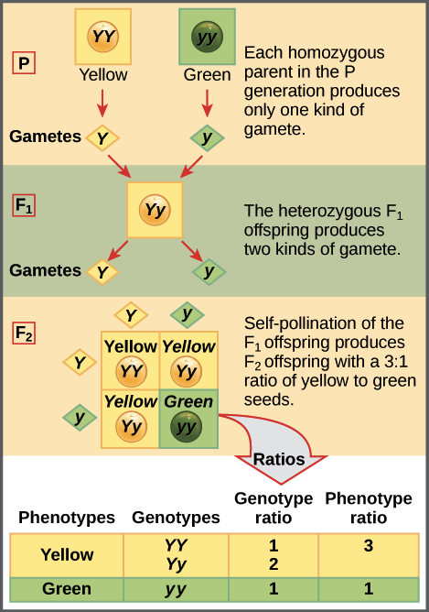
Topic Question 5: Describe Mendel’s Laws of inheritance
https://www.khanacademy.org/science/ap-biology/heredity/mendelian-genetics-ap/a/the-law-of-segregation

Slide 18
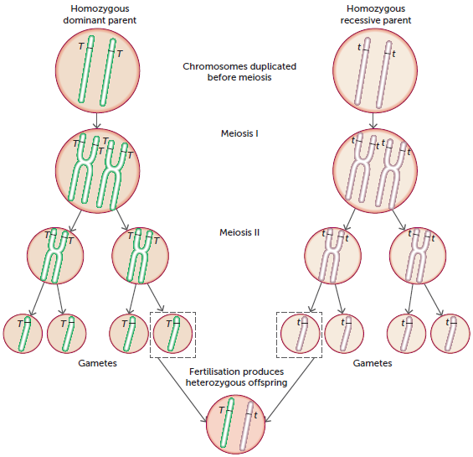
Genetics introduction
Topic Question 5: Describe Mendel’s Laws of inheritance
Two homozygous parents with different phenotypes can only produce heterozygous offspring.
The Characteristics of both parents are passed onto heterozygous offspring. Only the dominant allele will be observed in the offspring phenotype

Slide 19
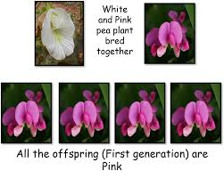
Topic Question 5: Describe Mendel’s Laws of inheritance
Law of Particulate or Dominance Inheritance
aa
AA
Aa

Slide 20
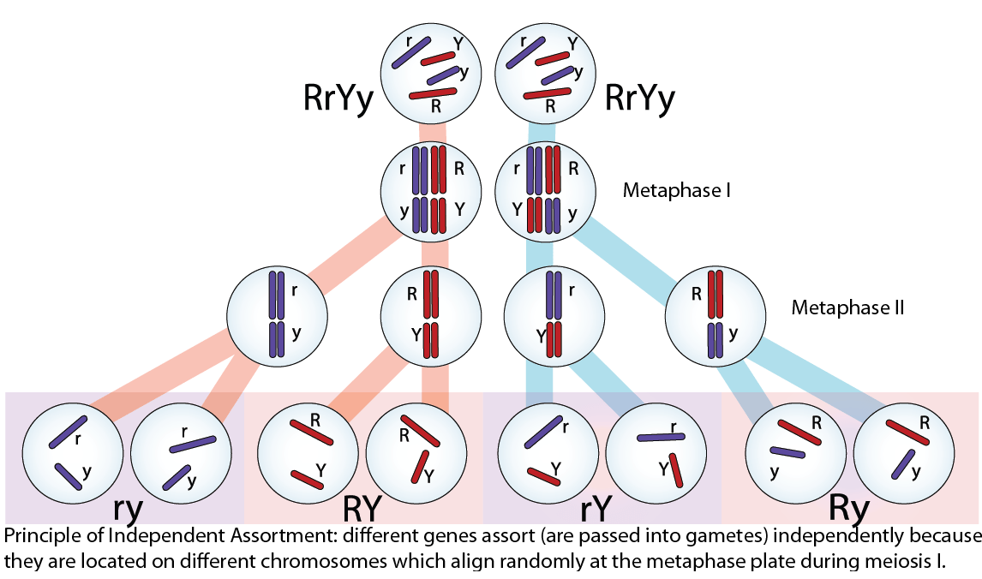
Topic Question 5: Describe Mendel’s Laws of inheritance
Law of independent Assortment
Alleles from 2 unlinked genes segregate independently

Slide 21
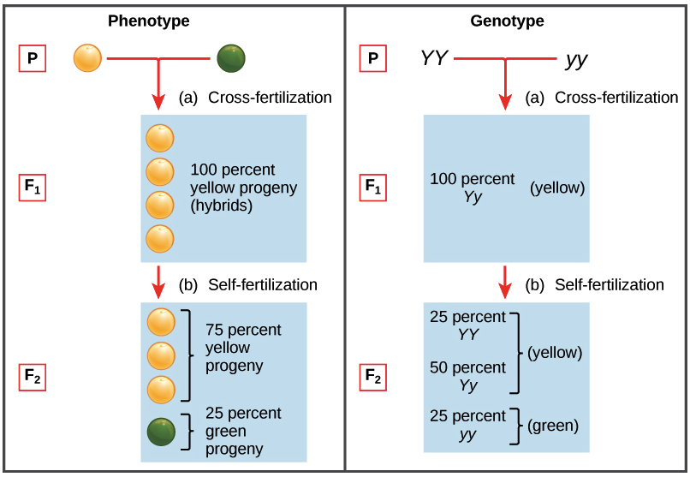
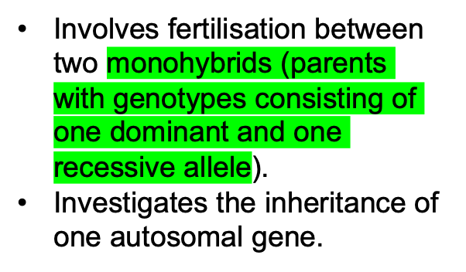
Topic Question 6: Explain what a Monohybrid cross is & state the ratios observed in the F₁ and F₂ generations
1. Monohybrid cross

Slide 22
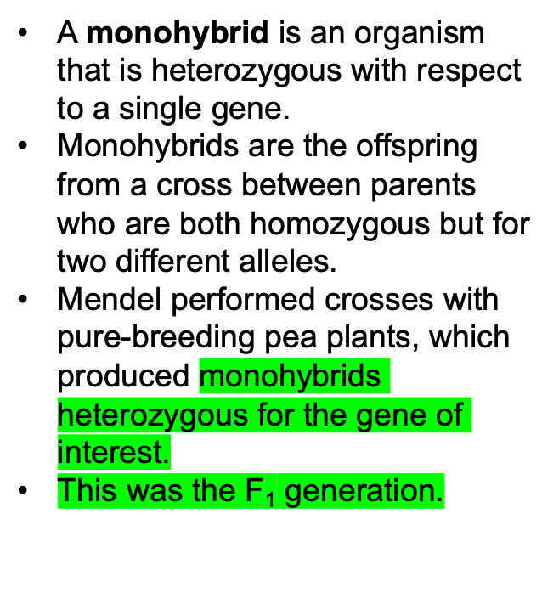
Topic Question 6: Describe Explain when Monohybrid cross is & state the ratios observed in the F₁ and F₂ generations
1. Monohybrid cross

Slide 23
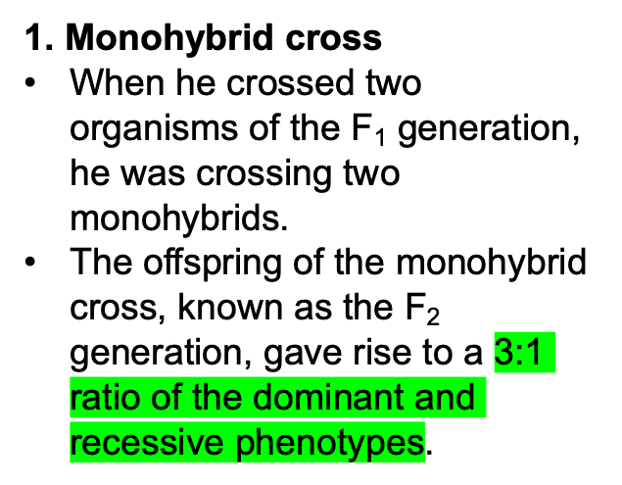
Genetics introduction
Topic Question 6: Describe Explain when Monohybrid cross is & state the ratios observed in the F₁ and F₂ generations
WATCH:
https://www.youtube.com/watch?v=i-0rSv6oxSY

Slide 24
Topic Question 7: Using the alleles P and p, draw a punnet square to show the ratio of pea plants with purple to white flowers among the offspring from the following crosses:
A pure-breeding purple plant with a pure-breeding white plant
A cross between two pea plants of the F₁ generation from the parental cross in Question 1
Read pages 138 – 133 Biology WA ATAR Units 3 & 4. Take note of the sample marking allocation for a question on monohybrid inheritance.

Slide 25
The test cross
Topic Question 8: Explain what a test cross is and how it can be used to determine the genotype of an organism
What are the possible genotypes?
If an organism’s genotype is unknown, and it is displaying a dominant phenotype, the genotype can be determined by performing a test cross.
The cross is usually with an organism that is homozygous recessive at the locus in question.
The ratio of phenotypes in the offspring reveals the unknown genotype.
Why
What are the possible ratio?
Genotype homozygous dominant?
Genotype heterozygous dominant?
OR

Slide 26
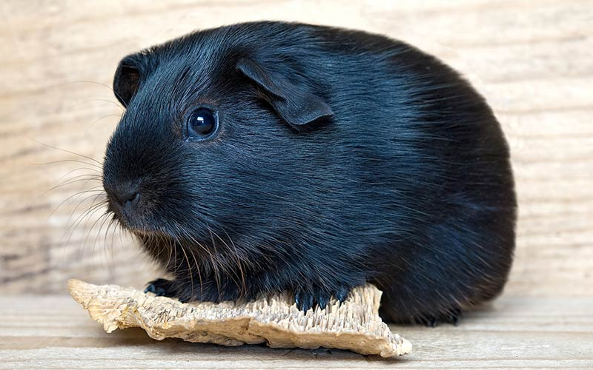
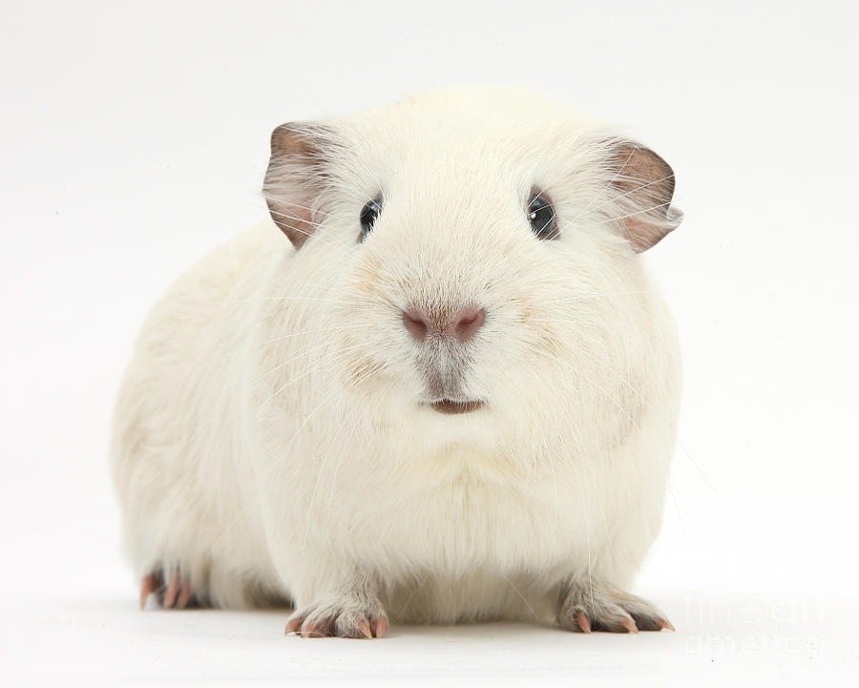
The test cross
Topic Question 8: Explain what a test cross is and how it can be used to determine the genotype of an organism
Example
In guinea pigs, black fur colour is dominant over white.
A test cross could be performed to find out the genotype of a black pet guinea pig with an unknown genotype.
If the owner wanted to be certain their pet was homozygous dominant black (for breeding purposes), they could breed the pet with a guinea pig who was homozygous recessive white.
Based on the percentage/ratio of offspring displaying the dominant phenotype the genotype of the unknown black guinea pig can be deduced

Slide 27
The test cross
Topic Question 8: Explain what a test cross is and how it can be used to determine the genotype of an organism
Black guinea pig’s genotype: BB
 | B | B
b | Bb | Bb
b | Bb | Bb
Genotype ratio: | 100% Bb
Phenotype ratio: | 100% black
Black guinea pig’s genotype: bb
 | B | b
b | Bb | bb
b | Bb | bb
Genotype ratio: | 50% Bb : 50% bb
Phenotype ratio: | 50% black : 50% white

Slide 28
Multiple alleles for one gene
Topic Question 9: Contrast multiple allele and monohybrid inheritance
Multiple Allele/Multiallelic | Monohybrid
More than 2 forms of alleles for a gene | Only 2 forms of alleles for a gene
A multiple allele system is present when 3 or more alleles of a gene exist among members of the population | In any one individual (monohybrid), only 2 alleles are normally present
Example: ABO blood group systems in humans, where there are there are three alleles possible for one gene. | Example: Gregor Mendel’s Pea plants

Slide 29
Multiple alleles for one gene
Topic Question 10: Explain why multiple allele systems show discontinuous variation
There are four possible phenotypes
  A, B, AB or 0
  Controlled by 3 alleles for 1 gene
There is no variation in between each blood group.
Phenotypes and genotypes for human blood groups
Phenotype | Genotype
Blood type A | I^{A}I^{A} or I^{A}i
Blood type B | I^{B}I^{B} or I^{B}i
Blood type AB | I^{A}I^{B}
Blood type O | ii

Slide 30
Multiple alleles for one gene
Topic Question 10: Explain why multiple allele systems show discontinuous variation
This leads to discontinuous variation
  because only one set of alleles for one gene determines the phenotype.
  Discontinuous variation is a set of discrete phenotypic categories controlled by a single gene and its set of alleles.
Phenotypes and genotypes for human blood groups
Phenotype | Genotype
Blood type A | I^{A}I^{A} or I^{A}i
Blood type B | I^{B}I^{B} or I^{B}i
Blood type AB | I^{A}I^{B}
Blood type O | ii

Slide 31
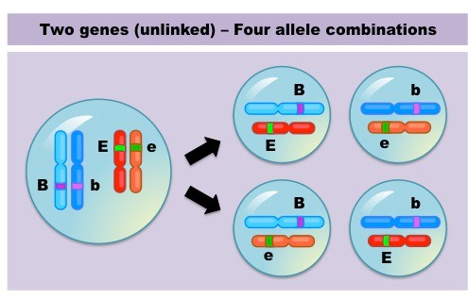
The dihybrid cross
Topic Question 11: Describe the inheritance of 2 unlinked autosomal genes
Mendel’s Law of Independent Assortment states the inheritance of one gene doesn’t affect the inheritance of another gene
A dihybrid cross involves two genes with two different alleles for each gene.
The inheritance of the two autosomal genes is independent of one another (they are not on the same chromosome)
Inheritance for two unlinked autosomal genes can be analysed with a dihybrid cross.

Slide 32
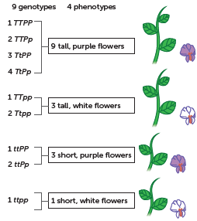
The dihybrid cross
Topic Question 12: Describe how to use a dihybrid cross
If the P generation are pure-breeding (homozygous) with respect to all traits, the F2 generation typically shows a ratio of 9:3:3:1.

Slide 33
The dihybrid cross
Topic Question 12: Describe how to use a dihybrid cross
The basic structure of a dihybrid cross Punnett square is a 4×4 grid for possible offspring,
with the four possible gamete allele combinations of one parent written across the top row and those of the other parent written down the left column.
A key is drawn up for the alleles and the cross.
Possible gametes (same for both parents):
 | TP | Tp | tP | tp
TP | TTPP | TTPp | TtPP | TtPp
Tp | TTPp | TTpp | TtPp | Ttpp
tP | TtPP | TtPp | ttPP | ttPp
tp | TtPp | Ttpp | ttPp | ttpp

Slide 34
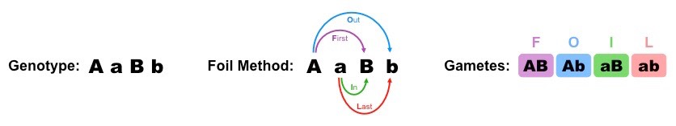
The dihybrid cross
Topic Question 13: Solve the following dihybrid cross
A pure-breeding fruit fly that has curly wings and red eyes is crossed with a pure-breeding fruit fly that has straight wings and purple eyes.
Their offspring all have curly wings and red eyes
1. Show this in a Punnett square
2. Two of the F₁ generation flies are crossed. If the alleles for wing shape and eye colour assort independently, predict the phenotypes of the F₂ generation and the proportions of each phenotype

Slide 35
Polygenic inheritance
Topic Question 14: Define polygenic inheritance
For one characteristic, two or more genes and therefore two or more sets of alleles contribute to a phenotype.
A characteristic controlled by more than one gene is known as a polygenic characteristic, and its transmission is called polygenic inheritance.
Polygenes consist of multiple genes, and each gene consists of multiple alleles.

Slide 36
Polygenic inheritance
Topic Question 15: Contrast multiallelic and polygenic inheritance

Slide 37
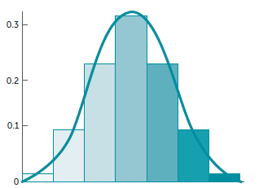
Polygenic inheritance
Topic Question 16: Using an example, explain why polygenic inheritance is said to show continuous variation
An example of polygenic inheritance is human height.
Humans have a range of heights, with a smooth gradation from one extreme to another. This can be seen when you line up for your school photographs each year.
The condition of showing a range
of phenotypes is called continuous variation.

Slide 38
Polygenic inheritance
Topic Question 17: Compare continuous and discontinuous variation
Factor | Continuous variation | Discontinuous variation
Type of inheritance that may lead to this variation | Polygenic inheritance (will have multiple alleles for each gene and several genes) | Single-gene inheritance (but may have multiple alleles)
Cause | Genetic and environmental factors | Genetic factors
Description | Variation that shows gradual changes from one trait to another. Differences are slight, along a continuum. | Variation that shows clear and discrete changes between traits. There is no intermediate form.

Slide 39
Polygenic inheritance
Topic Question 17: Compare continuous and discontinuous variation
Factor | Continuous variation | Discontinuous variation
Type of graphical representation | Histogram (a line graph can be superimposed to show continuous data) | Bar graph
Examples | Height, weight, skin colour | Ability or inability to tongue roll; attached or detached ear lobes; blood groups A, B, AB and O

Slide 40
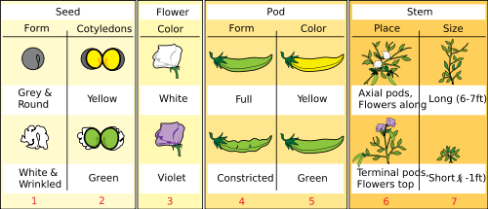
Dominant inheritance patterns
Topic Question 18: Name and describe the three dominant inheritance patterns
Complete dominance
When one allele is completely dominant over another.
The presence of the recessive allele is masked so the heterozygous individuals show the same phenotype as the homozygous dominant individuals.
Example:
Mendel’s pea plants

Slide 41
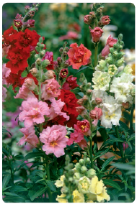
Dominant inheritance patterns
Topic Question 18: Name and describe the three dominant inheritance patterns
Incomplete dominance occurs when two different alleles are present, but neither allele is completely dominant.
Both alleles contribute to the phenotype,
but only partially.
A third intermediary phenotype is observed.
Example:
In pure-breeding snapdragons, incomplete dominance of the red flower colour and white flower colour results in a pink flower colour.
Science Photo Library/Adrian Thomas

Slide 42
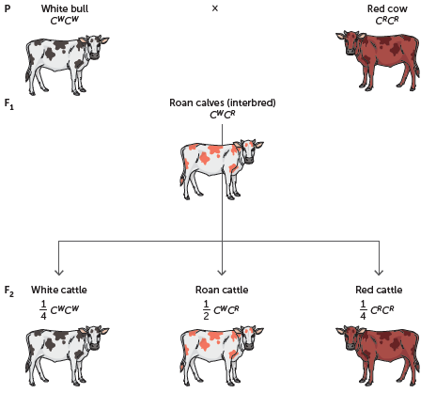
Dominant inheritance patterns
Topic Question 18: Name and describe the three dominant inheritance patterns
Codominance occurs
when two alleles are completely dominant.
Both alleles are observed and expressed in the phenotype.
Example:
In shorthorn cattle, codominant inheritance results in a roan coat colour in the offspring of pure-breeding red and white parents.

Slide 43
Dominant inheritance patterns
Topic Question 19: Review symbols used to show each dominant inheritance patterns
 | Complete dominance | Incomplete (partial) dominance | Codominance
Parents | BB, bb | C^{B}C^{B}, C^{W}C^{W} | C^{B}C^{B}, C^{W}C^{W}
Gametes | Bb | C^{B}C^{w} | C^{B}C^{w}
F1 genotype | Bb | C^{B}C^{W} | C^{B}C^{W}
Phenotype | Black | Grey | Black and white patches
Gametes | Bb, Bb | C^{B}C^{W}, C^{B}C^{W} | C^{B}C^{W}, C^{B}C^{W}
F2 genotype | BB, Bb, bb | C^{B}C^{B}, C^{B}C^{W}, C^{W}C^{W} | C^{B}C^{B}, C^{B}C^{W}, C^{W}C^{W}
Phenotype | Black White | Black Grey White | Black Black and white patches White
Heterozygote | Same as dominant | Intermediate between homozygous parents | Properties of both homozygous parents
Note: B and C^{B} = alleles for black coat colour; b and C^{W} = alleles for white coat colour
Biology WA Units 3 & 4
Set 5.7 pg. 150 Q 1-3

Slide 44
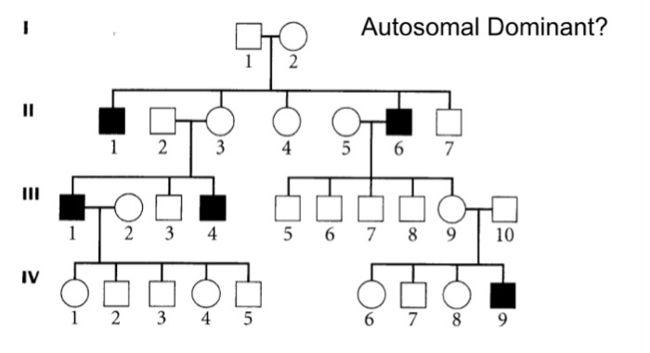
Topic Question 20: Illustrate the diagram to show how to read a pedigree
Marriage line
Generation Number
Line of descent
Sibling line

Slide 45
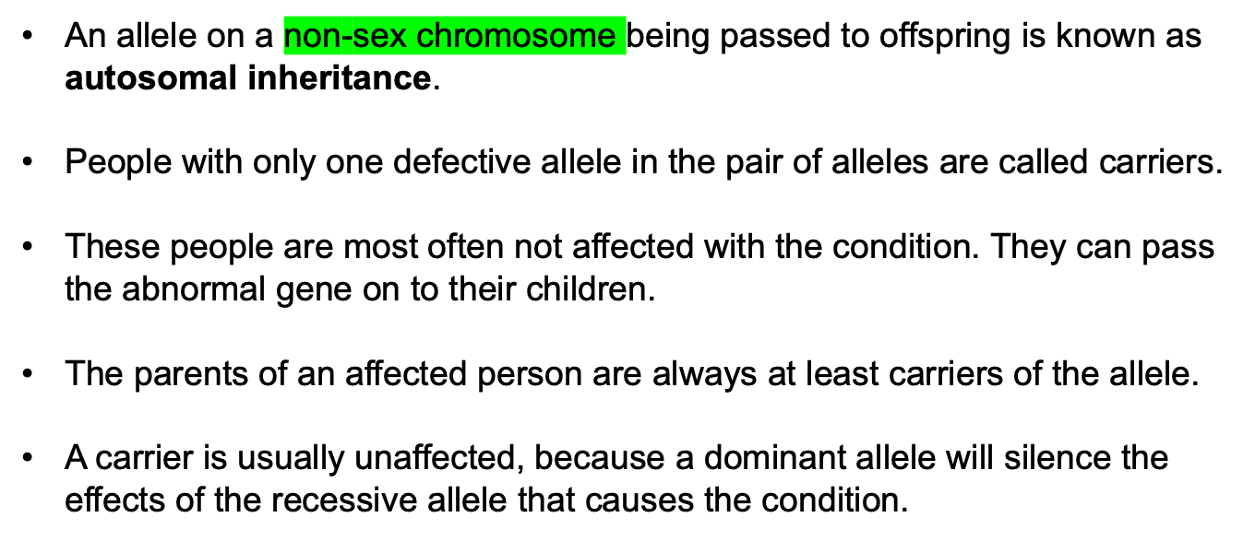
Autosomal recessive patterns
Modes of inheritance

Slide 46
Autosomal recessive patterns: example
Modes of inheritance

Slide 47
Modes of inheritance
One affected parent in the P generation has 4 unaffected offspring in the F₂ generation
Two unaffected parents in the F₁ generation had an affected son.
At least one of the parents would need to have had the allele, causing the condition to pass on to the son in the F₂ generation
If the allele was dominant, the F₁ parent would have been affected
Because the parents not affected, they must be carriers and the allele must be recessive.

Slide 48
Autosomal dominant patterns
Modes of inheritance
In autosomal dominant inheritance, a single dominant allele is responsible for the occurrence of a phenotype.
Each affected person usually has an affected parent, and the phenotype occurs in every generation.
A single copy of the affected allele is enough to cause the condition. A parent with a single copy of a dominant allele on an autosome (heterozygous) will theoretically pass it on to 50% of the offspring.
If the parent is homozygous for the dominant trait, then 100% of the offspring will be affected.

Slide 49
Autosomal dominant patterns: example
Modes of inheritance

Slide 50
Autosomal dominant patterns: example
Modes of inheritance
The trait affecting individuals is a dominant trait.
We know it is dominant because two of the offspring are unaffected, yet both parents are affected.
This means both parents were able to pass a recessive ‘normal’ allele to the unaffected offspring, which means both parents are heterozygous and affected.

Slide 51
X-linked recessive patterns
Modes of inheritance
When a recessive phenotype under investigation is determined by an allele on the X chromosome, it is said to be an X-linked recessive phenotype.
Males who have the recessive allele on their X chromosome will always express the phenotype, because they only have one X chromosome.
Females will only express the phenotype when both X chromosomes have the affected allele.
For a female child to be affected, the father must be affected and the mother must be either affected or a carrier.
A heterozygous female will be a carrier.

Slide 52
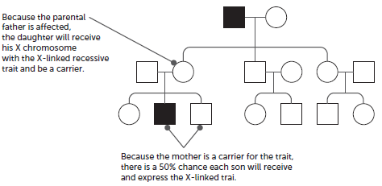
X-linked recessive patterns: example
Modes of inheritance
Source: Genetics Generation

Slide 53
X-linked dominant patterns
Modes of inheritance
The heterozygous females will always show the phenotype, and any individuals with the phenotype must have a parent with the phenotype.
Males showing the phenotype will not pass the affected allele on to their sons (because they must inherit their father’s Y chromosome), but they will pass it on to all their daughters, who will also show the phenotype. This is because daughters always inherit their father’s X chromosome (the other X chromosome comes from the mother).
A heterozygous female is expected to pass on the allele to 50% of her offspring, regardless of their sex.
The condition should appear in every generation.
An affected male receives the dominant allele from an affected mother.

Slide 54
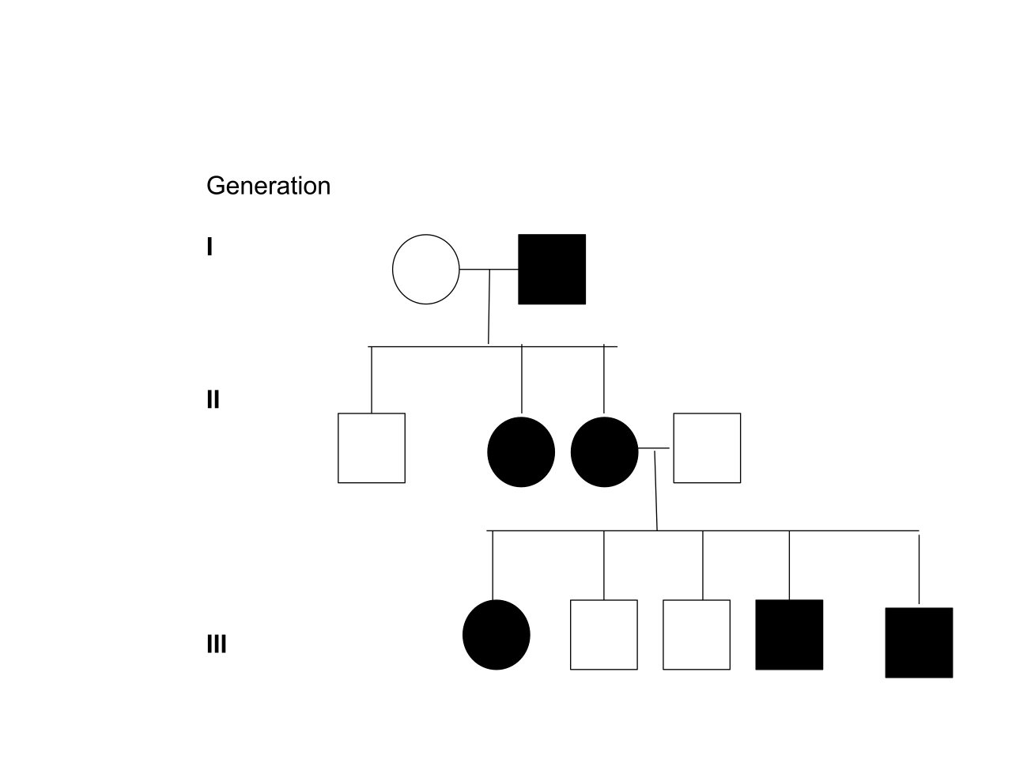
X-linked dominant patterns

Slide 55
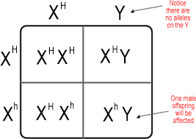
X-linked punnet squares

Slide 56
Y-linked patterns
Modes of inheritance
If a trait is carried on the Y chromosome, it is said to be Y-linked.
Only males are affected.
The most conspicuous phenotype associated with genes on the Y chromosome is male gender.

Slide 57
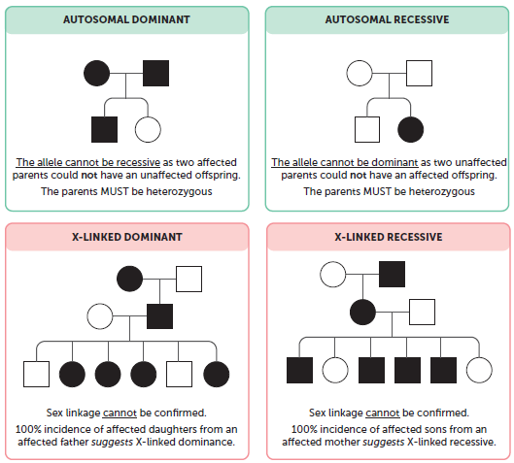
Inheritance patterns determined in a pedigree
Modes of inheritance

Slide 58
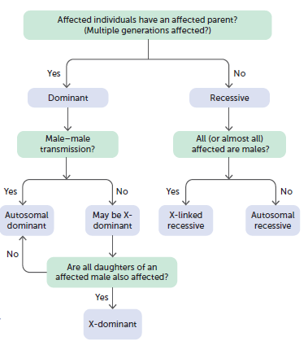
Mode of inheritance in a pedigree using a dichotomous key
Modes of inheritance

